Slide 1

Microprocessor on FPGA
CPU
Microprocessor & ES
Instructor: Bilal Moussa
Presented By: Elie Youssef
Fall 2022-2023

Slide 2
Introduction
Embedded microprocessor has been used as a tool for technological innovations and cost reduction
For a design to be competitive, its processor must be inexpensive, flexible, adaptable, fast and reconfigurable.
All these characteristics can be found using a Field-Programmable gate arrays as a design tool
GOAL OF THIS PROJECT: Realize an 8-bit FPGA based simple processor

Slide 3
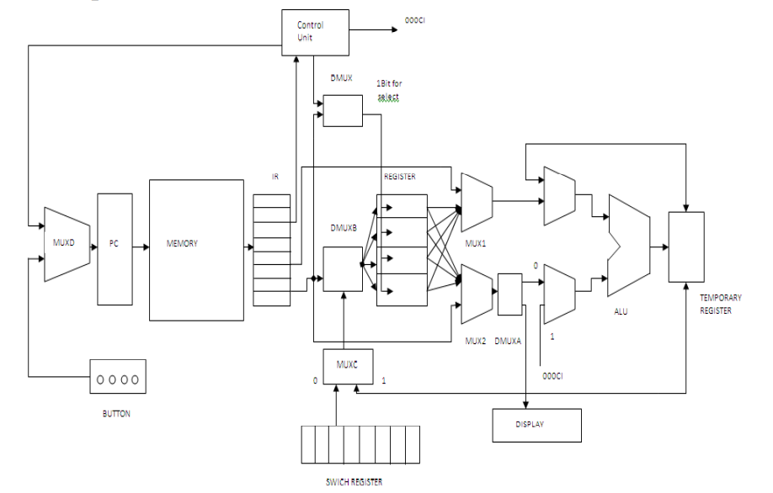
8-bit Processor Specs
16-word memory with 8-bit words
Four 4-bit registers
MUXA
MUXB
Start

Slide 4
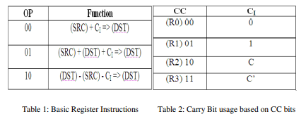
Instruction Type
1) Register Instructions
7 6 5 4 3 2 1 0
Op | Op | CC | CC | SRC | SRC | DST | DST
2) Branch Instructions
CC=01
or
CC=10 and Ci=1
or
CC=11 and Ci=0
7 6 5 4 3 2 1 0
1 | 1 | CC | CC | Address
3) Halt/IO Instructions
L=1 => enable loading from a fixed register to the data register specified
H=1 => display the information located in the destination register on the seven-segment display
L=1 and H=1 => Nothing happens
7 6 5 4 3 2 1 0
1 | 1 | 0 | 0 | H | L | DST | DST

Slide 5
Control Unit
MUXA
MUXB
Start

Slide 6
Control Unit
Control_unit
st
Show State type
Fetch_en
Enable fetch of inst from memory to IR
Reset
Incr_pc
Enable incrementation of pc
start
Src_reg_en
Enable to send value from source register along carry to ALU
dst_reg_en
Enable to send value from destination register
Ci_out_en
Enable ci_out input to muxb
op
addsub
0 for add and 1 for sub
cc
din
Enable inputs bits to be loaded into register pointed by dst
ssd
Enable for display content of dst register on 7seg
src
Pc_reg
Enable for address bits in IR to go to pc
c
ALUout
Enable for output of alu to go to dest reg
MUXA_out
Enable for outp of alu in first clock cycle to go a second time to alu
Ci_out
Carry out
CLK

Slide 7
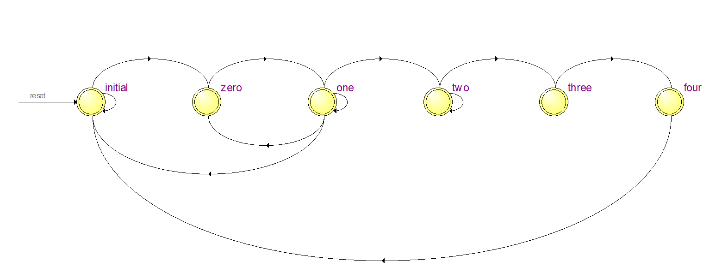
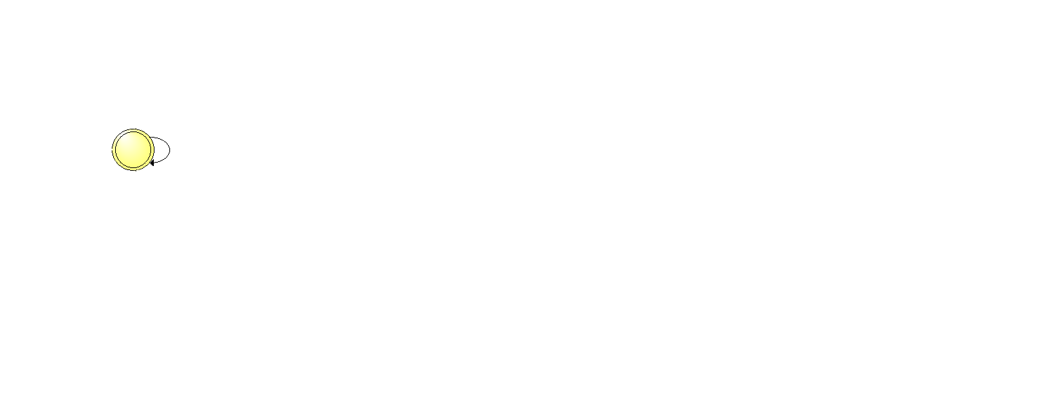
Control Unit
Finite State Machine

Slide 8
if cycle_count<1 then
cycle_count:=cycle_count+1;
else
state<=one;
cycle_count:=0;
fetch_en<=‘0';
end if;;
begin
P1:process (clk)
variable L: std_logic;
variable H: std_logic;
variable ci: std_logic;
variable cycle_count: natural;
begin
if reset='1' then
state<=initial;
elsif rising_edge (clk) then
case state is
when initial=>
if start='1' then
state<=zero;
incr_pc<='0';
end if;
when zero=> fetch_en<='1';
incr_pc<='0';
src_reg_en<='0';
dst_reg_en<='0';
ci_out_en<='0';
addsub<='0';
din<='0';
ssd<='0’;
pc_reg<='0';
ALUout<='0';
MUXA_out<='0';
ci_out<='0’;
L:='0';
H:='0';
ci:='0';
--Fetch

Slide 9

when one=>
if (op="00" or op="01" or op="10") then
state<=two;
src_reg_en<='1'; ci_out_en<='1'; addsub<='0’; -- Src+carry
if cc="00" then ci:='0'; elsif cc="01" then ci:='1';
elsif cc="10" then ci:=C; else ci:=not C; end if; ci_out<=ci;
elsif (H='1') then;
incr_pc<='1';
dst_reg_en<='1';
ssd<='1';
state<=initial;
end if;
elsif op="11" and (cc="01" or ((cc="10") and (ci='1')) or ((cc="11") and (ci='0'))) then
pc_reg<='1';
state<=zero;
fetch_en<='1';
end if;
--Decode
elsif op="11" and cc="00" then L:=src(0);
H:=src(1);
if (L='1') then
if cycle_count<1 then cycle_count:=cycle_count+1;
else cycle_count:=0; incr_pc<='1';
din<='1'; state<=zero; end if;
1 | 1 | 0 | 0 | H | L | DST | DST
Op | Op | CC | CC | SRC | SRC | DST | DST
1 | 1 | CC | CC | Address

Slide 10
--Execute arithmetic
elsif op="10" then
MUXA_out<='1';
dst_reg_en<='1';
ci_out_en<='0';
addsub<='1'; state<=three; end if;
end if;
when three=>
state<=four;
MUXA_out<='0';
when two=>
src_reg_en<='0';
incr_pc<='1’;
if op="00" then
state<=three; elsif op="01" then
MUXA_out<='1';
dst_reg_en<='1';
ci_out_en<='0';
addsub<='0';
state<=three;
incr_pc<='0';
dst_reg_en<='0';
ALUout<='1';
when four=>
ALUout<='0’;
fetch_en<='1';
state<=initial;
end case;
end if;
end process P1;
st<=state;

Slide 11
Switch Register
MUXA
MUXB
Start

Slide 12
7 6 5 4 3 2 1 0
1)
Op | Op | CC | CC | SRC | SRC | DST | DST
switch_reg
7 6 5 4 3 2 1 0
7 6 5 4 3 2 1 0
D
2)
1 | 1 | CC | CC | Address
Q
7 6 5 4 3 2 1 0
Goes to memory
3)
1 | 1 | 0 | 0 | H | L | DST | DST
Sync_Reset
CLK
process(Clk)
begin
if(rising_edge(Clk)) then
if(sync_reset='1') then
Q <= (others => '0');
else
Q <= D;
end if;
end if;
end process;
entity switch_reg is
port(
Q : out std_logic_vector(7 downto 0);
Clk : in std_logic;
sync_reset: in std_logic;
D : in std_logic_vector(7 downto 0)
);
end switch_reg;

Slide 13
Memory
MUXA
MUXB
Start

Slide 14
Inst_addr
0)
7 6 5 4 3 2 1 0
.
.
.
Inst_mem
addr
outp
15)
Wr_l
q
Sel_l
And_gate
memory
q
architecture behav of memory is
signal outp:std_logic;
signal and_gate:std_logic;
signal inst : mem_array_type:=(
"00000000","00000000","00000000","00000000","00000000","00000000","00000000","00000000","00000000","00000000","00000000","00000000","00000000","00000000","00000000","00000000");
Begin
outp<=not sel_l;
and_gate<=(not sel_l) and (not wr_l);
inst(addr)<=inst_addr when and_gate='1';
q<=inst(addr) when outp='1' and and_gate='0';
inst_mem<=inst;
end behav;
entity memory is port(
inst_addr: in std_logic_vector(7 downto 0);
sel_l: in std_logic;
wr_l: in std_logic;
inst_mem: out mem_array_type:=(
"00000000","00000000","00000000","00000000","00000000","00000000","00000000","00000000","00000000","00000000","00000000","00000000","00000000","00000000","00000000","00000000");
q: out std_logic_vector(7 downto 0) :="00000000";
addr: in natural
);
end memory;
package mem_array is
type mem_array_type is array(0 to 15) of std_logic_vector(7 downto 0);
end package;

Slide 15
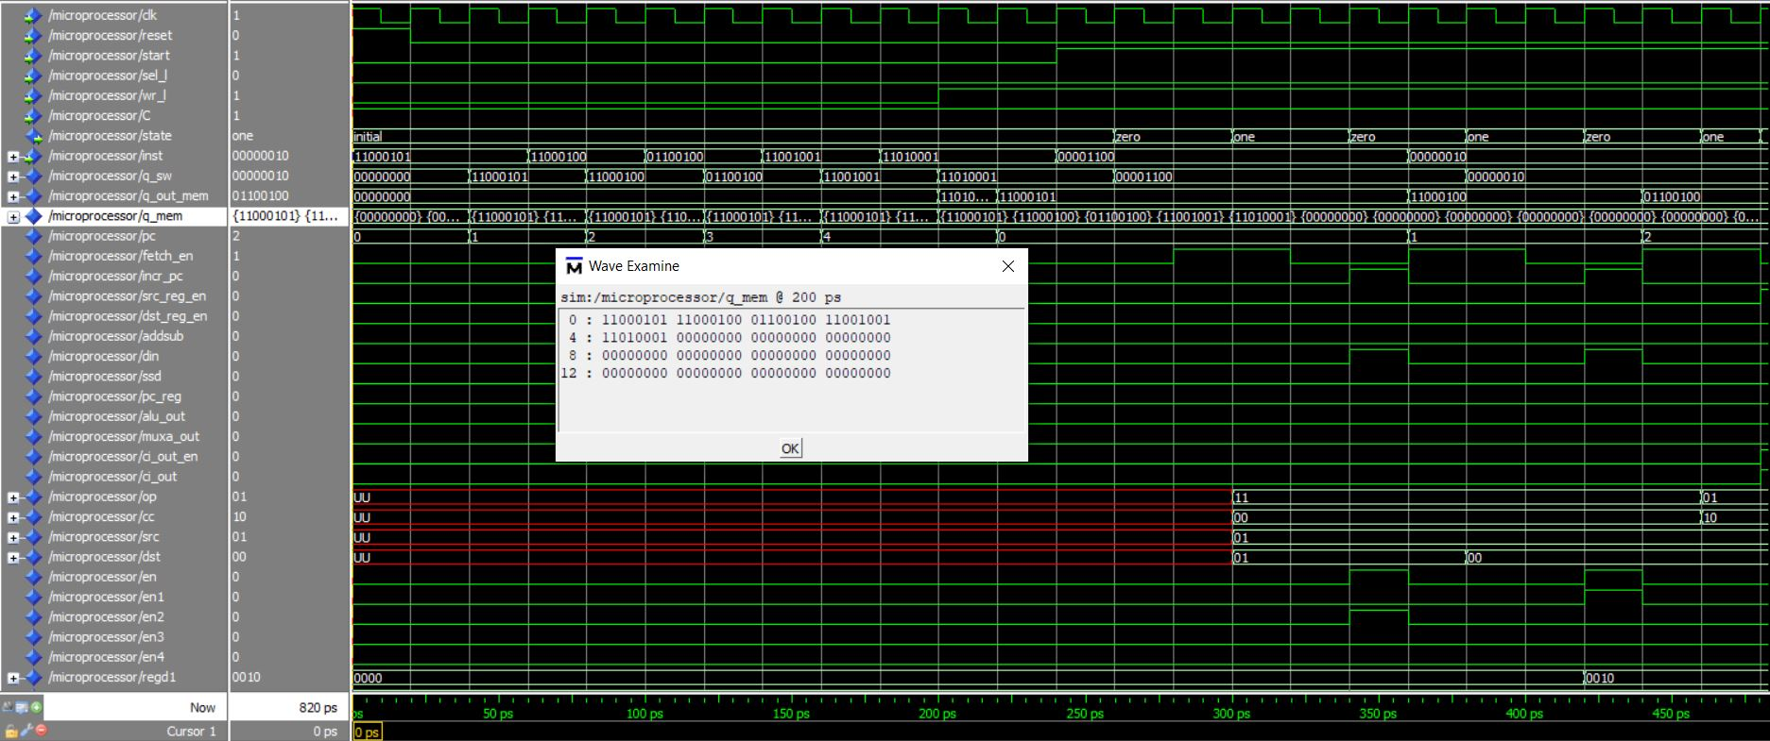

Slide 16
Inst_addr
0)
7 6 5 4 3 2 1 0
.
.
.
Inst_mem
addr
outp
15)
Wr_l
q
Sel_l
And_gate
memory
q
architecture behav of memory is
signal outp:std_logic;
signal and_gate:std_logic;
signal inst : mem_array_type:=(
"00000000","00000000","00000000","00000000","00000000","00000000","00000000","00000000","00000000","00000000","00000000","00000000","00000000","00000000","00000000","00000000");
Begin
outp<=not sel_l;
and_gate<=(not sel_l) and (not wr_l);
inst(addr)<=inst_addr when and_gate='1';
q<=inst(addr) when outp='1' and and_gate='0';
inst_mem<=inst;
end behav;
entity memory is port(
inst_addr: in std_logic_vector(7 downto 0);
sel_l: in std_logic;
wr_l: in std_logic;
inst_mem: out mem_array_type:=(
"00000000","00000000","00000000","00000000","00000000","00000000","00000000","00000000","00000000","00000000","00000000","00000000","00000000","00000000","00000000","00000000");
q: out std_logic_vector(7 downto 0) :="00000000";
addr: in natural
);
end memory;
package mem_array is
type mem_array_type is array(0 to 15) of std_logic_vector(7 downto 0);
end package;

Slide 17
Multiplexer-D
MUXA
MUXB
Start

Slide 18
Incr_pc: Enable incrementation of pc
Control_Unit
Incr_pc
enable
Input User
start
entity muxd is port (
start,incr_pc:in std_logic;
enable:out std_logic);
end muxd;
architecture m of muxd is
begin
enable<='1' when (start='1' and incr_pc='1') else '0';
end m;
muxd

Slide 19
Program Counter
MUXA
MUXB
Start

Slide 20
PC
Pc_reg: In case of Branch operation where we need to load data into specific address, enable for address bits in IR to go to pc
Incr_pc
Control Unit
Pc_reg
counter
Goes to addr of memory
src
dst
architecture count of pc1 is
signal cnt:natural;
begin
P1:process (clk,reset)
begin
if reset='1' then
cnt<=0;
elsif rising_edge (clk) then
if pc_reg='1' then
cnt<=to_integer(unsigned(src & dst));
elsif incr_pc ='1' then
cnt<=cnt+1;
end if;
end if;
end process P1;
counter<=cnt;
end count;
reset
CLK
entity pc1 is port (
clk,reset,incr_pc,pc_reg:in std_logic;
src,dst:in std_logic_vector(1 downto 0);
counter:out integer natural);
end pc1;

Slide 21
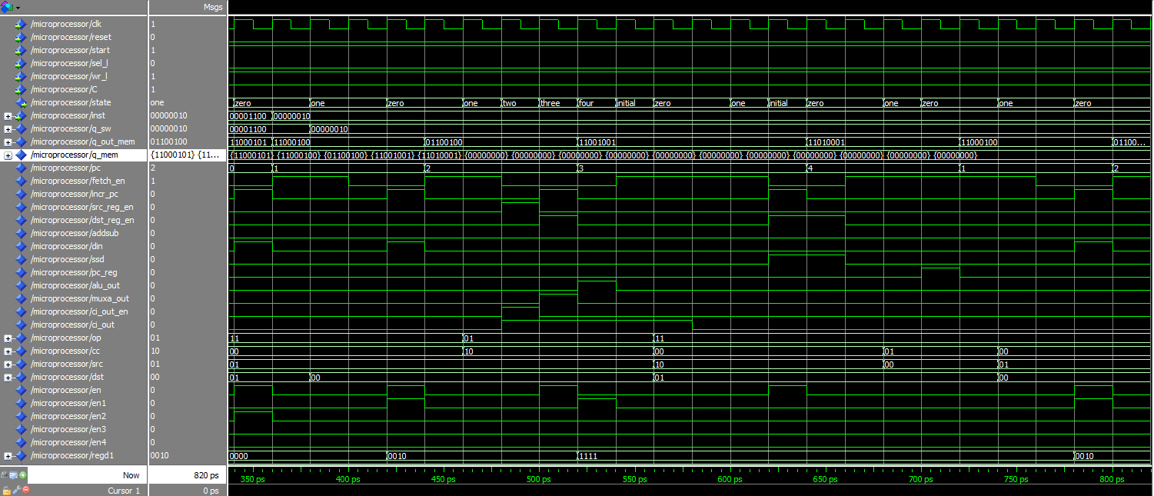
1 | 1 | CC | CC | Address
Branch Instruction go to memory’s 2nd address
7 6 5 4 3 2 1 0

Slide 22
Inst_addr
0)
7 6 5 4 3 2 1 0
.
.
.
Inst_mem
addr
outp
7)
Wr_l
q
Sel_l
And_gate
memory
q
entity memory is port(
inst_addr:in std_logic_vector(7 downto 0);
sel_l:in std_logic;
wr_l:in std_logic;
inst_mem:out mem_array_type;
q:out std_logic_vector(7 downto 0);
addr:in integer range 0 to 7 -- to be replaced by counter
);
end memory;
architecture behav of memory is
signal outp:std_logic;
signal and_gate:std_logic;
signal inst : mem_array_type;
begin
outp<=not sel_l;
and_gate<=(not sel_l) and (not wr_l);
inst(addr)<=inst_addr when and_gate='1';
q<=inst(addr) when outp='1' and and_gate='0';
inst_mem<=inst;
end behav;
package mem_array is
type mem_array_type is array(0 to 7) of std_logic_vector(7 downto 0);
end package;

Slide 23
Instruction Register
MUXA
MUXB
Start

Slide 24
7 6 5 4 3 2 1 0
Fetch_enable: Enable fetch of inst from memory to IR
Instruction_register
en
Op | Op | CC | CC | SRC | SRC | DST | DST
op
Control_Unit
cc
inst
src
dst
architecture ir of instruction_register is
begin
P1:process (clk)
begin
if rising_edge (clk) then
if en='1' then
op<=inst(7 downto 6);
cc<=inst(5 downto 4);
src<=inst(3 downto 2);
dst<=inst(1 downto 0);
end if;
end if;
end process P1;
end ir;
CLK
entity instruction_register is port (
clk:in std_logic;
en:in std_logic;
inst:in std_logic_vector (7 downto 0);
op,cc,src,dst:out std_logic_vector(1 downto 0));
end instruction_register;

Slide 25
Demultiplexer
MUXA
MUXB
Start

Slide 26
dmux
en1
Din: enable for inputs bits loaded into register pointed by dst
din
en2
en3
Enable to send value in source register along carry to ALU
Alu_out: enable for output of alu to go to dest reg
Alu_out
en4
architecture d of dmux is
begin
en1<='1' when ((alu_out='1' or din='1') and dst="00") else '0';
en2<='1' when ((alu_out='1' or din='1') and dst="01") else '0';
en3<='1' when ((alu_out='1' or din='1') and dst="10") else '0';
en4<='1' when ((alu_out='1' or din='1') and dst="11") else '0';
end d;
dst
entity dmux is port (
dst: in std_logic_vector (1 downto 0); --sel
din,alu_out: in std_logic;
en1,en2,en3,en4: out std_logic);
end dmux;

Slide 27
Four 4-bit registers
MUXA
MUXB
Start

Slide 28
3 2 1 0
reg
Data
reset
q1
en1
en2
q2
en3
q3
en4
q4
d1
architecture r of reg is
begin
reg1: entity RisingEdge_DFlipFlop_SyncReset port map (q1,clk,en1,reset,d1);
.
.
.
reg4: entity RisingEdge_DFlipFlop_SyncReset port map (q4,clk,en4,reset,d4);
end r;
d2
d3
d4
CLK
if(rising_edge(Clk)) then
if(sync_reset='1') then
Q <= (others => '0');
elsif(en = '1') then
Q <= D;
end if;
end if;
entity reg is port (
clk,reset:in std_logic;
en1,en2,en3,en4:in std_logic;
q1,q2,q3,q4:out std_logic_vector(3 downto 0) :="0000";
d1,d2,d3,d4:in std_logic_vector (3 downto 0));
end reg;

Slide 29
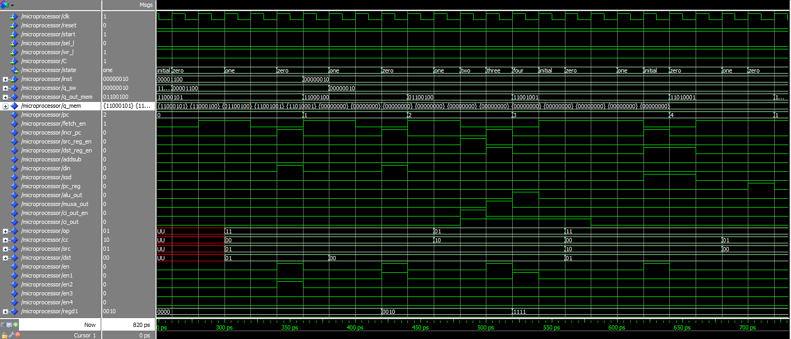
1 | 1 | 0 | 0 | H | L | DST | DST
L=1=> Load value from Switch register in register reg2
7 6 5 4 3 2 1 0

Slide 30
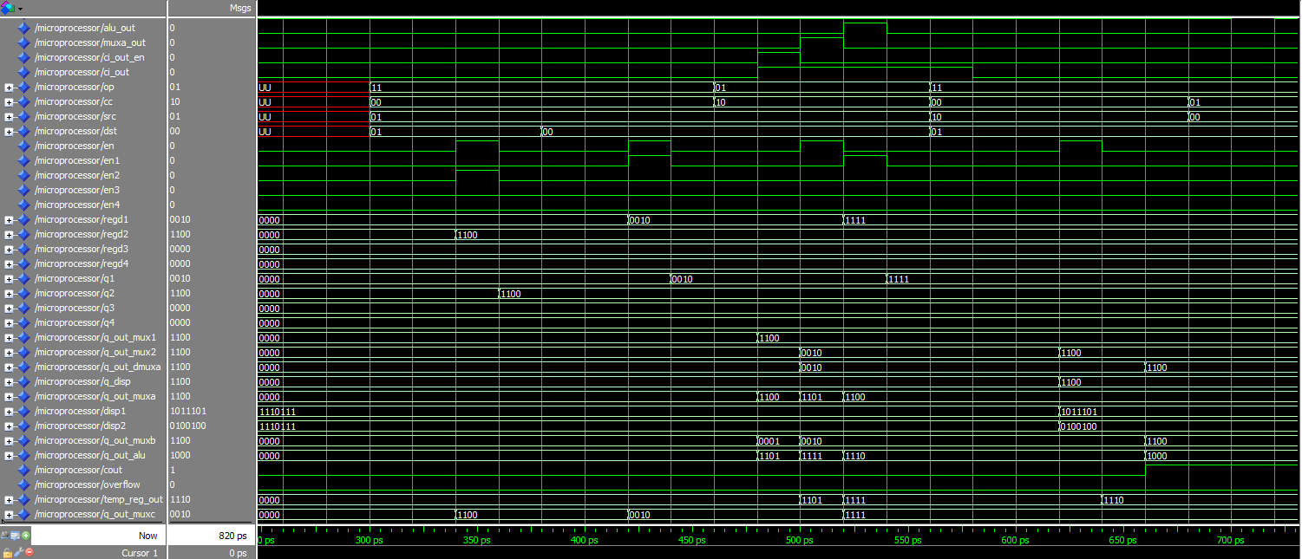

Slide 31
1 | 1 | 0 | 0 | H | L | DST | DST
L=1=> Load value from Switch register in register reg1
7 6 5 4 3 2 1 0

Slide 33
Multiplexer 1
MUXA
MUXB
Start

Slide 34
mux1
Value coming from either reg1,2,3 or 4
Val_in1
Val_in2
Val_out
Val_in3
Val_in4
Src_reg_en:Enable to send value from source register along carry to ALU
en
architecture m1 of mux1 is
begin
val_out<=val_in1 when (sel="00" and en='1') else val_in2 when (sel="01" and en='1')
else val_in3 when (sel="10" and en='1') else val_in4
when (sel="11" and en='1') else "0000";
end m1;
Sel (src)
entity mux1 is port (
sel:in std_logic_vector (1 downto 0);
en:in std_logic;
val_in1,val_in2,val_in3,val_in4: in std_logic_vector (3 downto 0);
val_out: out std_logic_vector (3 downto 0) :="0000");
end mux1;

Slide 35
Multiplexer A
MUXA
MUXB
Start

Slide 36
muxa
Alu_out
Value from ALU
Val_out
D_reg
Muxa_out : Enable for outp of alu in first clock cycle to go a second time to alu
en
entity muxa is port (
alu_out,d_reg:in std_logic_vector (3 downto 0);
en:in std_logic;
val_out:out std_logic_vector (3 downto 0) :="0000");
end muxa;
architecture ma of muxa is
begin
val_out<=alu_out when en='1' else d_reg;
end ma;

Slide 37
Multiplexer 2
MUXA
MUXB
Start

Slide 38
mux2
Value coming from either reg1,2,3 or 4
Val_in1
Val_in2
Val_out
Val_in3
Val_in4
Dst_reg_en: Enable to send value from destination register
en
architecture m2 of mux2 is
begin
val_out<=val_in1 when (sel="00" and en='1’)
else val_in2 when (sel="01" and en='1')
else val_in3 when (sel="10" and en='1’)
else val_in4 when (sel="11" and en='1’)
else "0000";
end m2;
Sel (dst)
entity mux2 is port (
sel:in std_logic_vector (1 downto 0);
en:in std_logic;
val_in1,val_in2,val_in3,val_in4: in std_logic_vector (3 downto 0);
val_out: out std_logic_vector (3 downto 0) :="0000");
end mux2;

Slide 39
Demultiplexer A
MUXA
MUXB
Start

Slide 40
dmuxa
Val_out
Val_in
Value coming from dst reg
Display_out
Display
ssd : Enable for display content of dsp register on 7seg
sel
entity dmuxa is port(
val_in:in std_logic_vector (3 downto 0);
sel:in std_logic;
val_out:out std_logic_vector(3 downto 0) :="0000";
display_out:out std_logic_vector(3 downto 0) :="0000");
end dmuxa;
architecture da of dmuxa is
begin
val_out<=val_in when sel=‘0’;
display_out<=val_in when sel='1’;
end da;

Slide 41
7 Segment Display
MUXA
MUXB
Start

Slide 42
Display
entity display is port (
val_in:in std_logic_vector (3 downto 0);
disp1,disp2:out std_logic_vector(0 to 6):="1110111");
end display;
architecture d of display is
begin
disp1<="1110111" when val_in="0000" or val_in="1010" else
"0100100" when val_in="0001" or val_in="1011" else
"1011101" when val_in="0010" or val_in="1100" else
"1101101" when val_in="0011" or val_in="1101" else
"0101110" when val_in="0100" or val_in="1110" else
"1101011" when val_in="0101" or val_in="1111" else
"1111011" when val_in="0110" else
"0100101" when val_in="0111" else
"1111111" when val_in="1000" else
"1101111" when val_in="1001";
6
6
5
4
5
4
3
3
2
1
2
1
0
0
disp2
disp1
isp2<="1110111" when val_in="0000" or val_in="0001" or val_in="0010" or
val_in="0011" or val_in="0100" or val_in="0101" or
val_in="0110" or val_in="0111" or val_in="1000" or
val_in="1001" else
"0100100" when val_in="1010" or val_in="1011" or val_in="1100" or
val_in="1101" or val_in="1110" or val_in="1111" ;
End d;

Slide 43
1 | 1 | 0 | 0 | H | L | DST | DST
H=1 => display value in reg2 on 7seg display
7 6 5 4 3 2 1 0

Slide 44
Disp2
Disp1
6
6
5
4
5
4
3
3
2
1
2
1
0
0

Slide 45
Multiplexer B
MUXA
MUXB
Start

Slide 46
muxb
Val_in
Val_out
Ci_out
Ci_out_en : Enable ci_out input to muxb
en
entity muxb is port (
val_in:in std_logic_vector (3 downto 0);
ci_out:in std_logic;
en:in std_logic;
val_out:out std_logic_vector (3 downto 0) :="0000");
end muxb;
architecture mb of muxb is
signal tmp:std_logic_vector(3 downto 0);
begin
tmp<="000" & ci_out;
val_out<=tmp when en='1' else val_in;
end mb;

Slide 47
ALU
MUXA
MUXB
Start

Slide 48
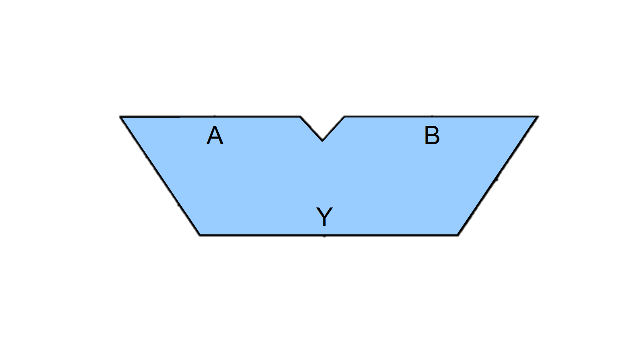
MUXA
A
MUXB
B
R
Cout
signal C1, C2, C3, C4: std_logic:='0';
signal TMP: std_logic_vector(3 downto 0);
signal res:std_logic_vector(3 downto 0);
Overflow
ADDSUB
TMP(0)<='0';
TMP(1)<=B(1) when op='0' else not B(1);
TMP(2)<=B(2) when op='0' else not B(2);
TMP(3)<=B(3) when op='0' else not B(3);
FA0:full_adder port map(A(0),B(0),OP, R(0),C1);
FA1:full_adder port map(A(1),TMP(1),C1, R(1),C2);
FA2:full_adder port map(A(2),TMP(2),C2, R(2),C3);
FA3:full_adder port map(A(3),TMP(3),C3, R(3),C4);
OVERFLOW <= C3 XOR C4 ;
Cout <= C4;
R<=res(3) & res(2) & res(1) & res (0);
OP
entity alu is
port( OP: in std_logic;
A,B : in std_logic_vector(3 downto 0);
R : out std_logic_vector(3 downto 0):="0000";
Cout, OVERFLOW : out std_logic);
end alu;

Slide 49
Temporary Register
MUXA
MUXB
Start

Slide 50
Temp_reg
D
Src_reg_en: Enable to send value from source register along carry to ALU
Src_reg_en
Q
dst_reg_en: Enable to send value from destination register
dst_reg_en
Sync_Reset
CLK
if(rising_edge(Clk)) then
if(sync_reset='1') then
Q <= (others => '0');
elsif(src_reg_en = '1' or dst_reg_en='1’)then
Q <= D;
end if;
end if;

Slide 51
Multiplexer C
MUXA
MUXB
Start

Slide 52
muxc
7 6 5 4 3 2 1 0
SW_in
Instruction or data
Val_out
Tmp_in
Alu_out: Enable for output of alu to go to dest reg
din: Enable for inputs bits loaded into register pointed by dst
din
Alu_out
entity muxc is port (
sw_in:in std_logic_vector (3 downto 0);
Tmp_in:in std_logic;
Alu_out,din:in std_logic;
val_out:out std_logic_vector (3 downto 0):="0000" );
end muxc;
architecture mc of muxc is
Begin
val_out<=sw_in when din='1' else tmp_in when alu_out=‘1’;
end mc;

Slide 53
Demultiplexer B
MUXA
MUXB
Start

Slide 54
reg
dmuxb
q1
d1
Regd_1
d2
q2
Val_in
Regd_2
d3
q3
Alu_out: Enable for output of alu to go to dest reg
Alu_out
Regd_3
d4
q4
din: Enable for inputs bits loaded into register pointed by dst
din
Regd_4
reset
en1
en2
en3
en4
Sel (dst)
architecture db of dmuxb is
begin
regd_1<=val_in when sel="00" and (alu_out='1' or din='1');
regd_2<=val_in when sel="01" and (alu_out='1' or din='1');
regd_3<=val_in when sel="10" and (alu_out='1' or din='1');
regd_4<=val_in when sel="11" and (alu_out='1' or din='1’);
end db;
entity dmuxb is port(
val_in:in std_logic_vector (3 downto 0);
alu_out,din:in std_logic;
sel:in std_logic_vector (1 downto 0);
regd_1,regd_2,regd_3,regd_4:out std_logic_vector(3 downto 0);
end dmuxb;

Slide 55
Op | Op | CC | CC | SRC | SRC | DST | DST
Add src reg along with carry with dest reg and put result in dest reg
7 6 5 4 3 2 1 0
Reg2
Reg1
Reg1

Slide 56
Carry=1

Slide 57
THANK YOU!
QUESTIONS?

